Slide 1
Electronic-Waste System Developed in PHP & MySQL

Slide 2
Abstract
Electronic waste has been a significant problem in society. It causes environmental pollution and is responsible for producing lead, mercury, and other toxins and hazardous chemicals. In addition, in some cases, the disposal processes such as burning and landfilling generate harmful gases such as nitrogen oxide. It is very necessary to recycle electronic waste so we develop web application which help collect the electronic product and recycle them. In addition, it was also necessary to determine what type of material will be recycled in remanufacturing and why the specific materials are used for the remanufacturing processes.

Slide 3
Introduction
Electronic Waste System is a web based technology which manages electronic waste. This web application provides interface between organization(who recycled the waste products) and User(Who have electronic waste). In this application user list the details of products and pickup addresses.
The user can create the account and whenever they are having electronic waste they can login and list the details of product and admin see that product and sent their employee to investigate details of products then employee decide to reject product or collect that product to sent for recycle.
In this project we use PHP and MySQL database and it has three module i.e. Admin, Employee and User.

Slide 4
Scope of the Project
In proposed system we are reduce electronic waste using this application. This web application help to collect electronic waste from users and recycled that waste which enormously help to social innovation that tackles environment health and recycled e-waste. The admin assign product to their employee and employee can collect electronic waste from user and investigate that product and sent it to recycle. This collection will reduce e-waste from the household, company, city, state etc. The environment pollution will reduce and electronic waste will recycled. This web application could eliminate waste disposal costs, reduce raw material costs and provide income from a salable waste.

Slide 5
Modules
In this project we use PHP and MySQL database and it has three module i.e. Admin, Employee and User.

Slide 6
Admin Module
Dashboard: In this section, admin can view total state, total city, Total Registered Users, Total Employee, Total Listed Product, New Product Listed, Assign Products, Collected Products, Product sent for recycle, Recycled Products, Rejected Product.
State: In this section, admin can manage state (Add/Update/Del).
City: In this section, admin can manage city (Add/Update/Del).
Employee: In this section, admin can manage employee (Add/Update/Del).
Reg User: In this section, admin can view registered users who listed their e-waste.
Listed Products: In this section, admin can view the listed product which is listed by users.
Assigned Products: In this section, admin can assign the employee for investigating the listed product.
Unassigned Products: In this section, admin can view un-assign product which is pending on administrator side.
Product Status: In this section, admin can view the status of listed product and view what action is taken by their employees.
Pages: In this section, admin can manage about us and contact us pages.
Search Listed Products: In this section admin, search products request by product id, name and mobile number.
Reports: In this section admin can view listed product, registered users and employees in particular period.
Admin can also update his profile, change the password and recover the password.

Slide 7
Employee Module
Dashboard: In this section, employee can view assign product request, collected product, sent for recycle product, recycled products and rejected product by him/her.
Assign Request: In this section, employee can view the details of assign products and have right to take decision to reject or collect the product.
Search: In this section, employee can search assign product request by product id.
Employee can also update his profile, change the password and recover the password.

Slide 8
User Module
Dashboard: In this section, user can view assign product request, collected product, sent for recycle product, recycled products, rejected product and pending product which is listed by him/her.
List Your Products: In this section, user can list the electronic product details and manage that product.
Product Status: In this section, user can view the status of products which is listed by him/her.
Search: In this section, user can search listed product request by product id which is provided by administrator.

Slide 9
Requirement Specification
Hardware Configuration:
Client Side
Server Side
RAM | 512 MB
Hard Disk | 10GB
Processor | 1.0 GHz
RAM | 1 GB
Hard Disk | 20GB
Processor | 2.0GHz

Slide 10
Continue.....
Software Requirement:
Client Side
Server Side
Web Browser | Google Chrome or any compatible browser
Operating System | Windows or any equivalent OS
Web Server | APACHE
Server side Language | PHP5.6 or above version
Database Server | MySQL
Web Browser | Google Chrome or any compatible browser
Operating System | Windows or any equivalent OS

Slide 11
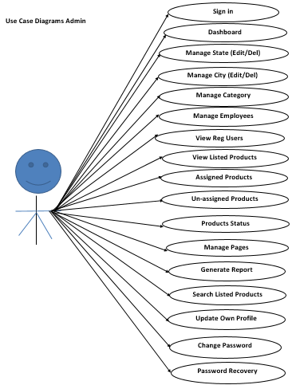
Use Case Diagram
Notes:
USECASE DIAGRAM: A Use case is a description of set of sequence of actions. Graphically it is rendered as an ellipse with solid line including only its name. Use case diagram is a behavioral diagram that shows a set of use cases and actors and their relationship. It is an association between the use cases and actors. An actor represents a real-world object. Primary Actor – Sender, Secondary Actor Receiver.

Slide 12
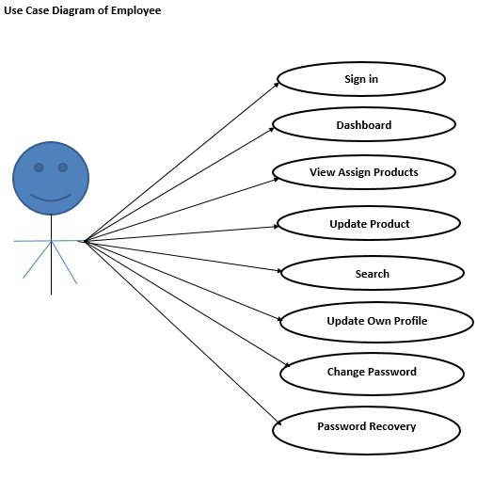
Continue.......

Slide 13
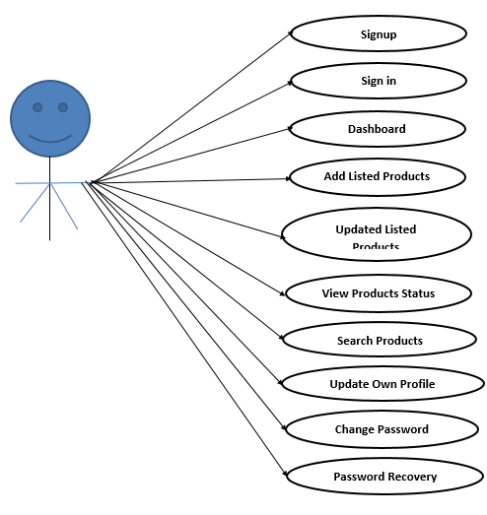
Continue.......
User Use Case Diagram

Slide 14
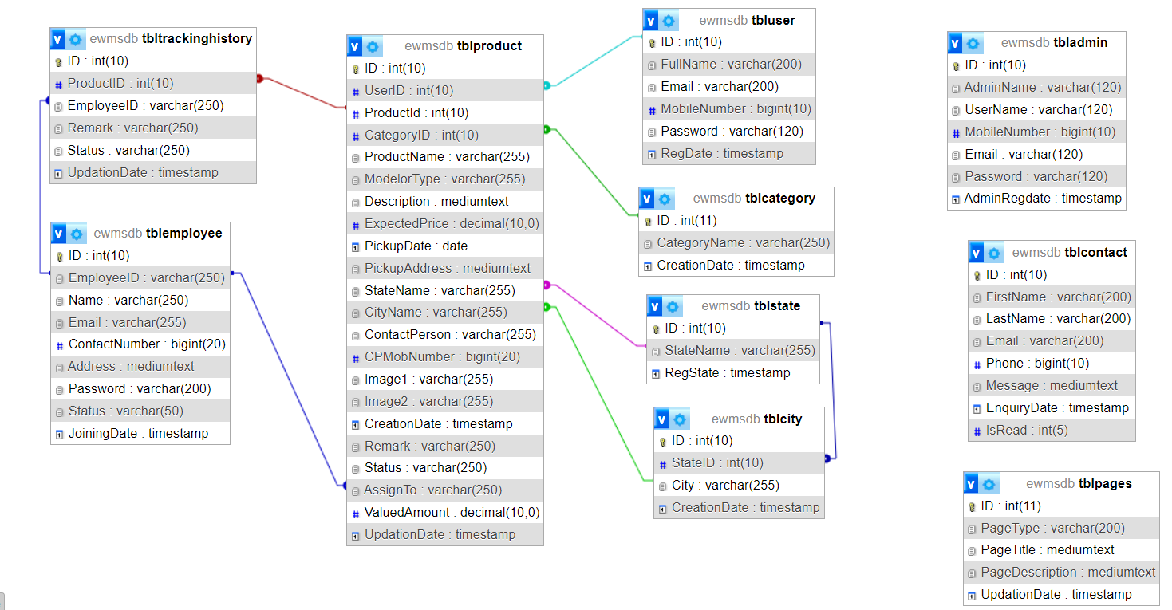
Schema Diagram

Slide 15
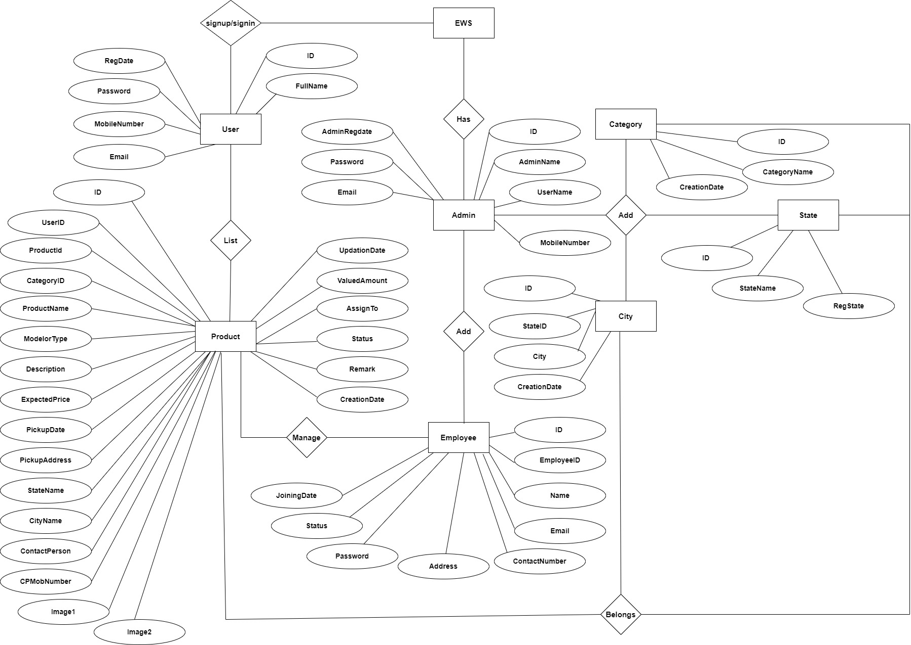
ER Diagram

Slide 16
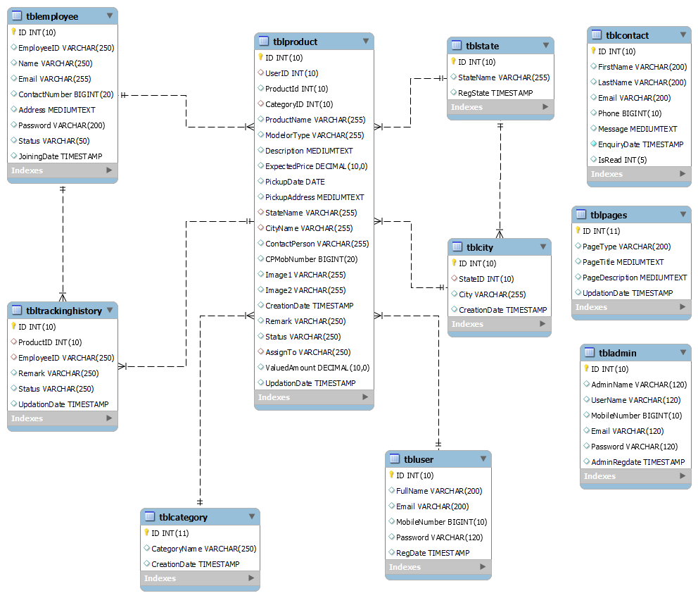
Class Diagram
Notes:
A description of set of objects that share the same attributes operations, relationships, and semantics.

Slide 17
Data Flow Diagrams
A Data Flow Diagram (DFD) is a traditional visual representation of the information flows within a system. A neat and clear DFD can depict the right amount of the system requirement graphically. It can be manual, automated, or a combination of both.
It shows how data enters and leaves the system, what changes the information, and where data is stored.
The objective of a DFD is to show the scope and boundaries of a system as a whole. It may be used as a communication tool between a system analyst and any person who plays a part in the order that acts as a starting point for redesigning a system. The DFD is also called as a data flow graph or bubble chart.

Slide 18
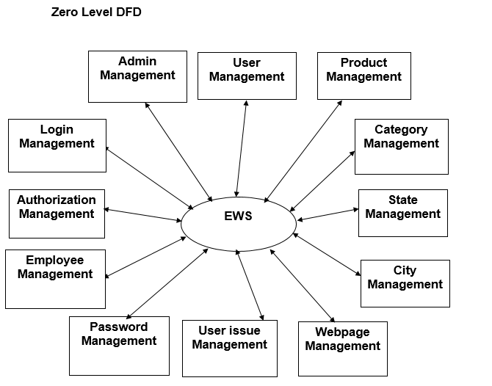
ZERO Level

Slide 19
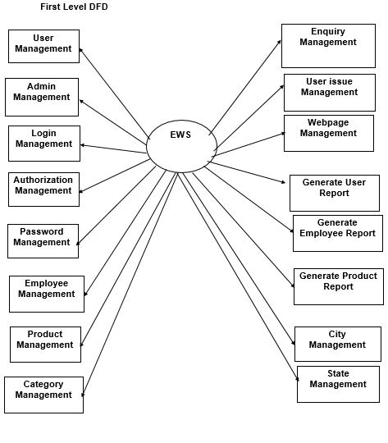
First Level

Slide 20
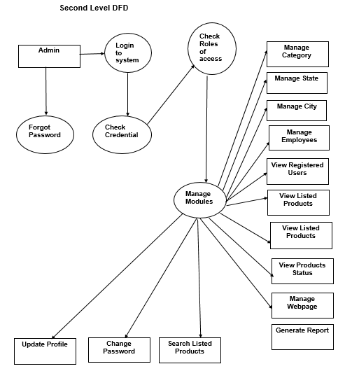
Second Level

Slide 21
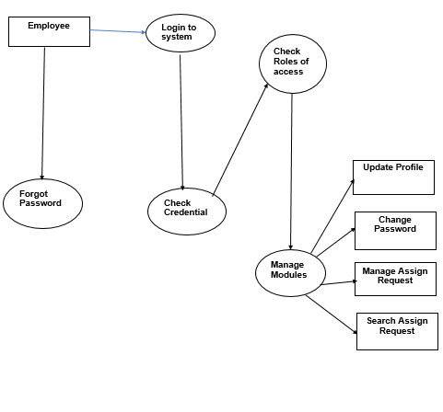

Slide 22
Implementation and System Testing
After all phase have been perfectly done, the system will be implemented to the server and the system can be used.
System Testing
The goal of the system testing process was to determine all faults in our project .The program was subjected to a set of test inputs and many explanations were made and based on these explanations it will be decided whether the program behaves as expected or not. Our Project went through two levels of testing
Unit testing
Integration testing

Slide 23
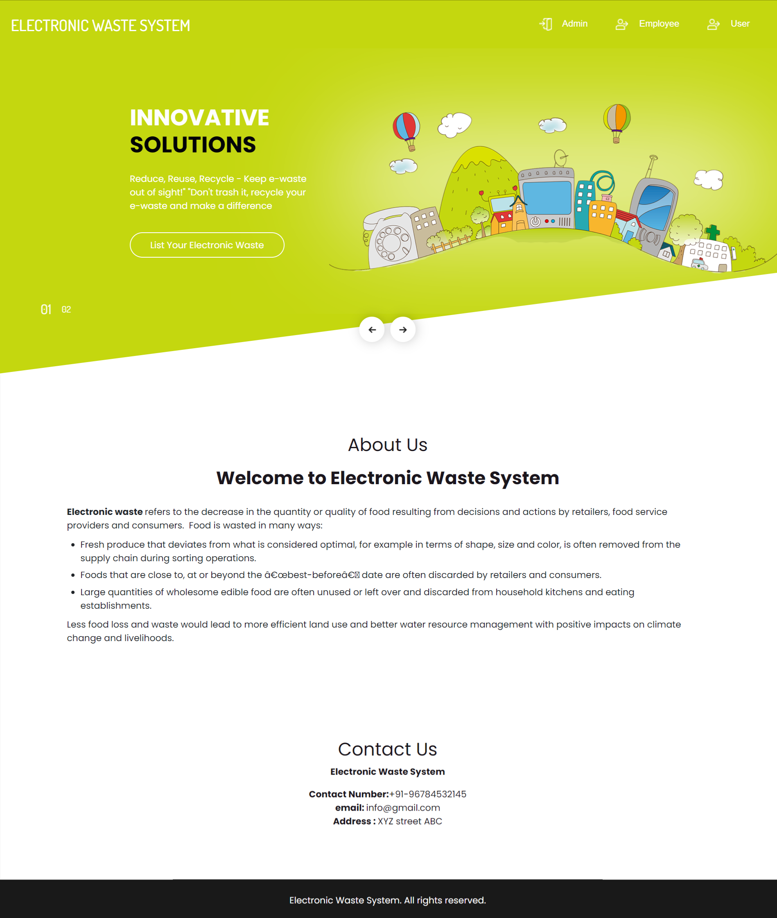
Project Screens

Slide 24
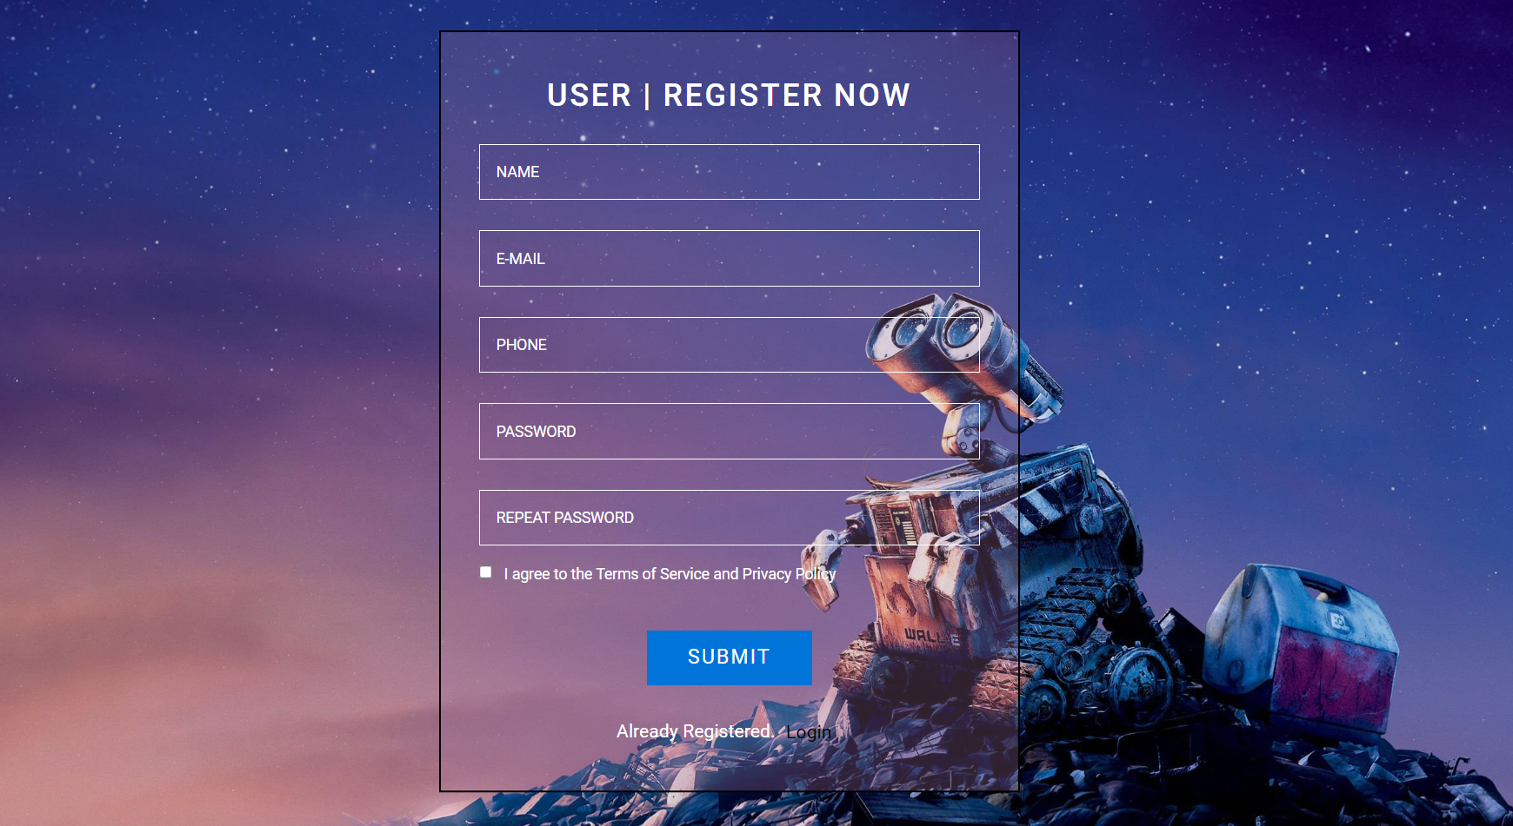
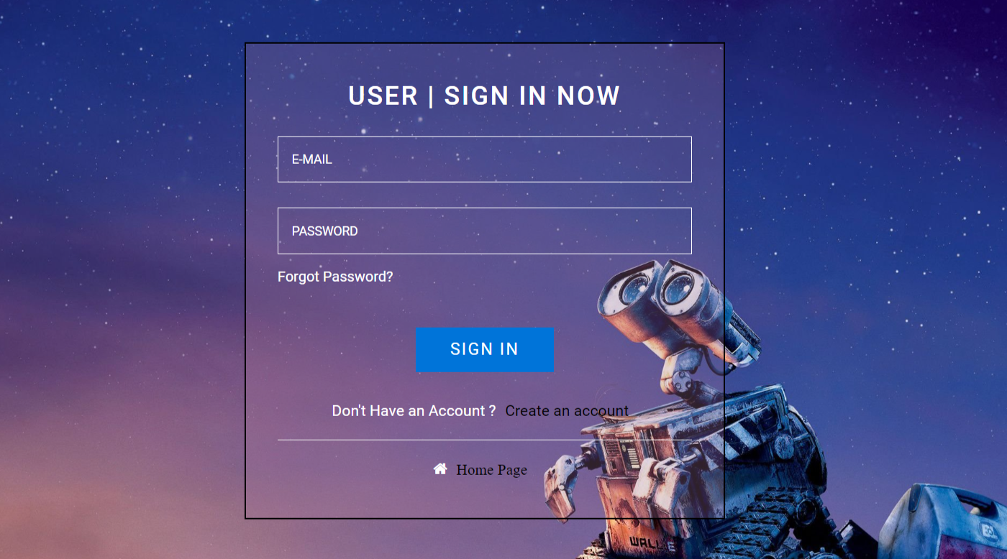

Slide 25
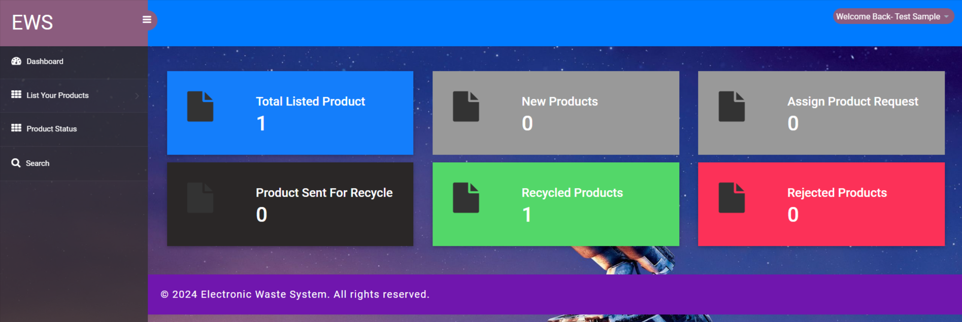
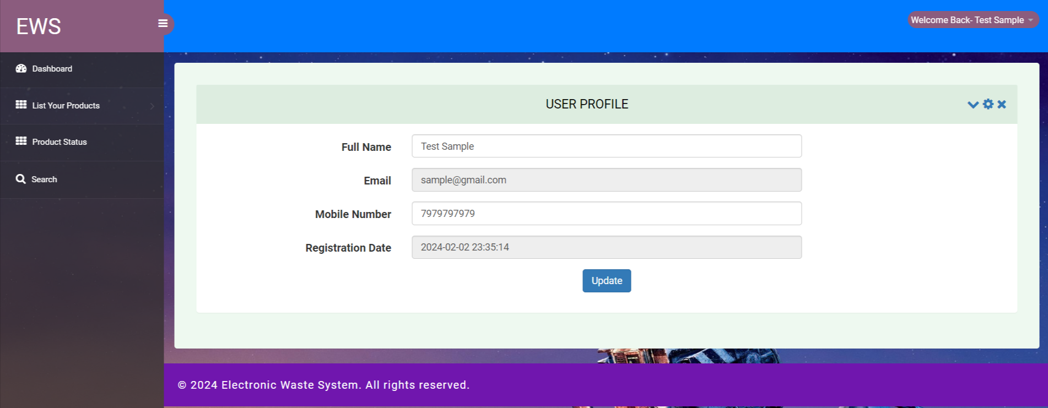

Slide 26
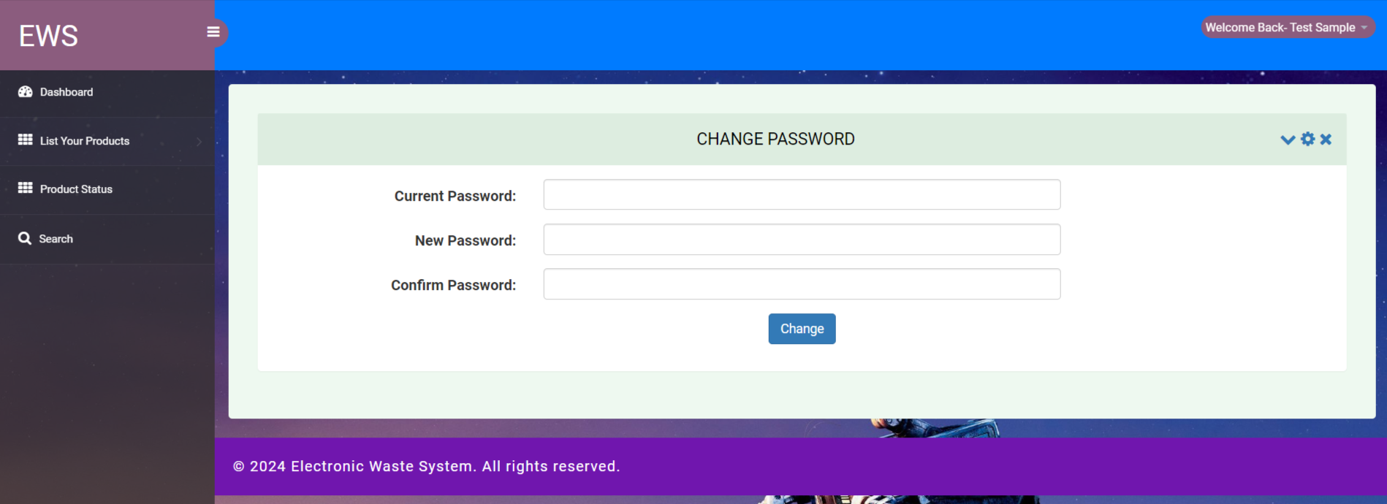
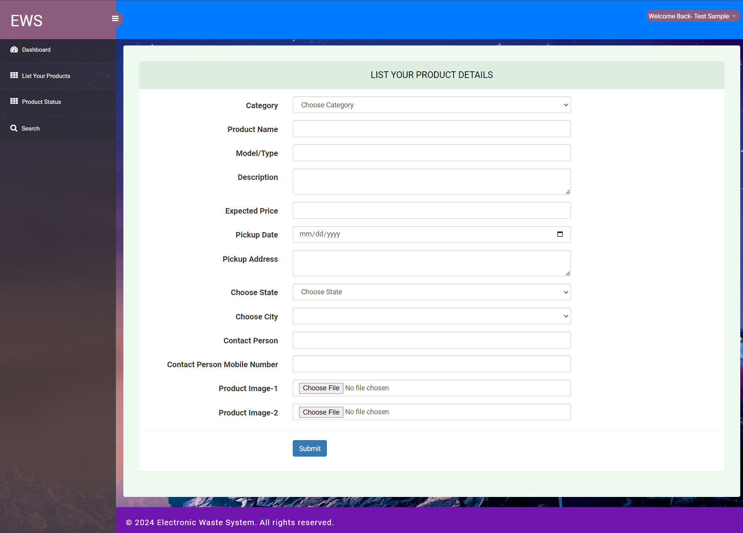

Slide 27
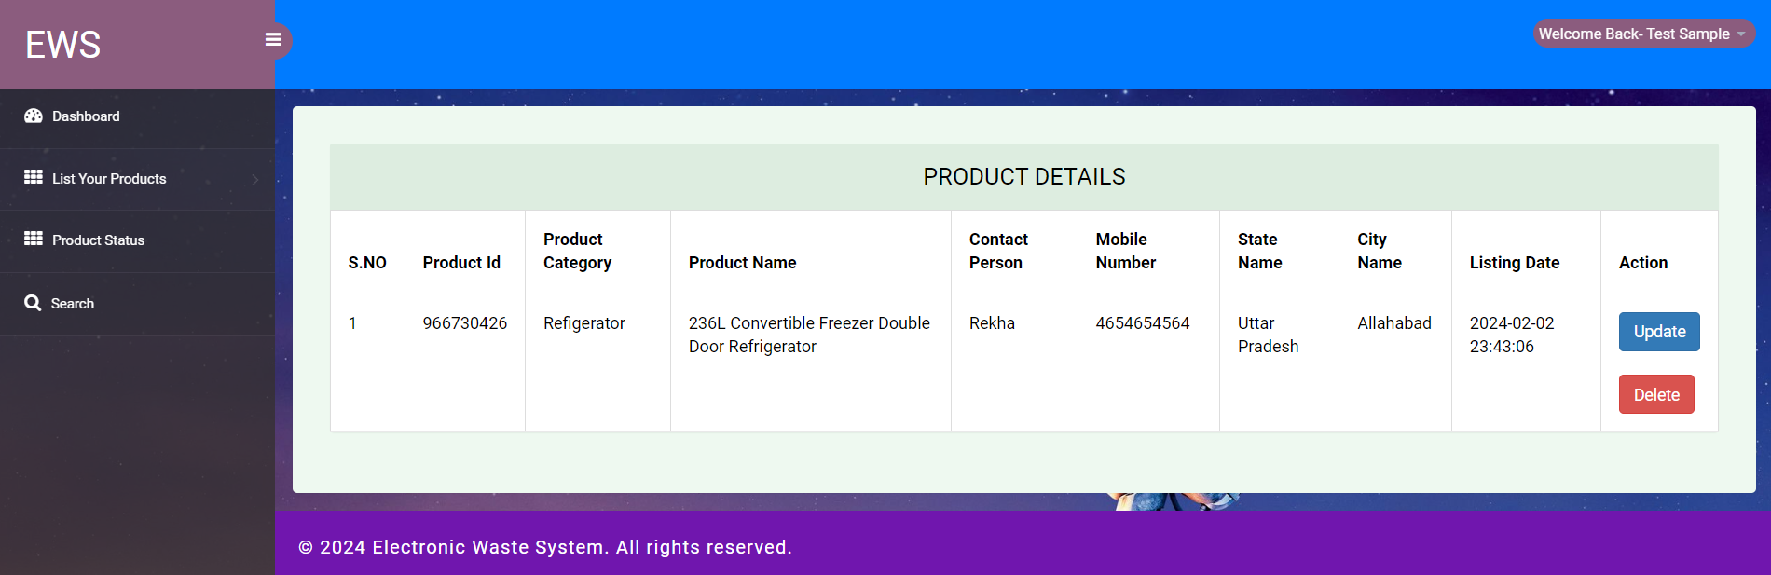
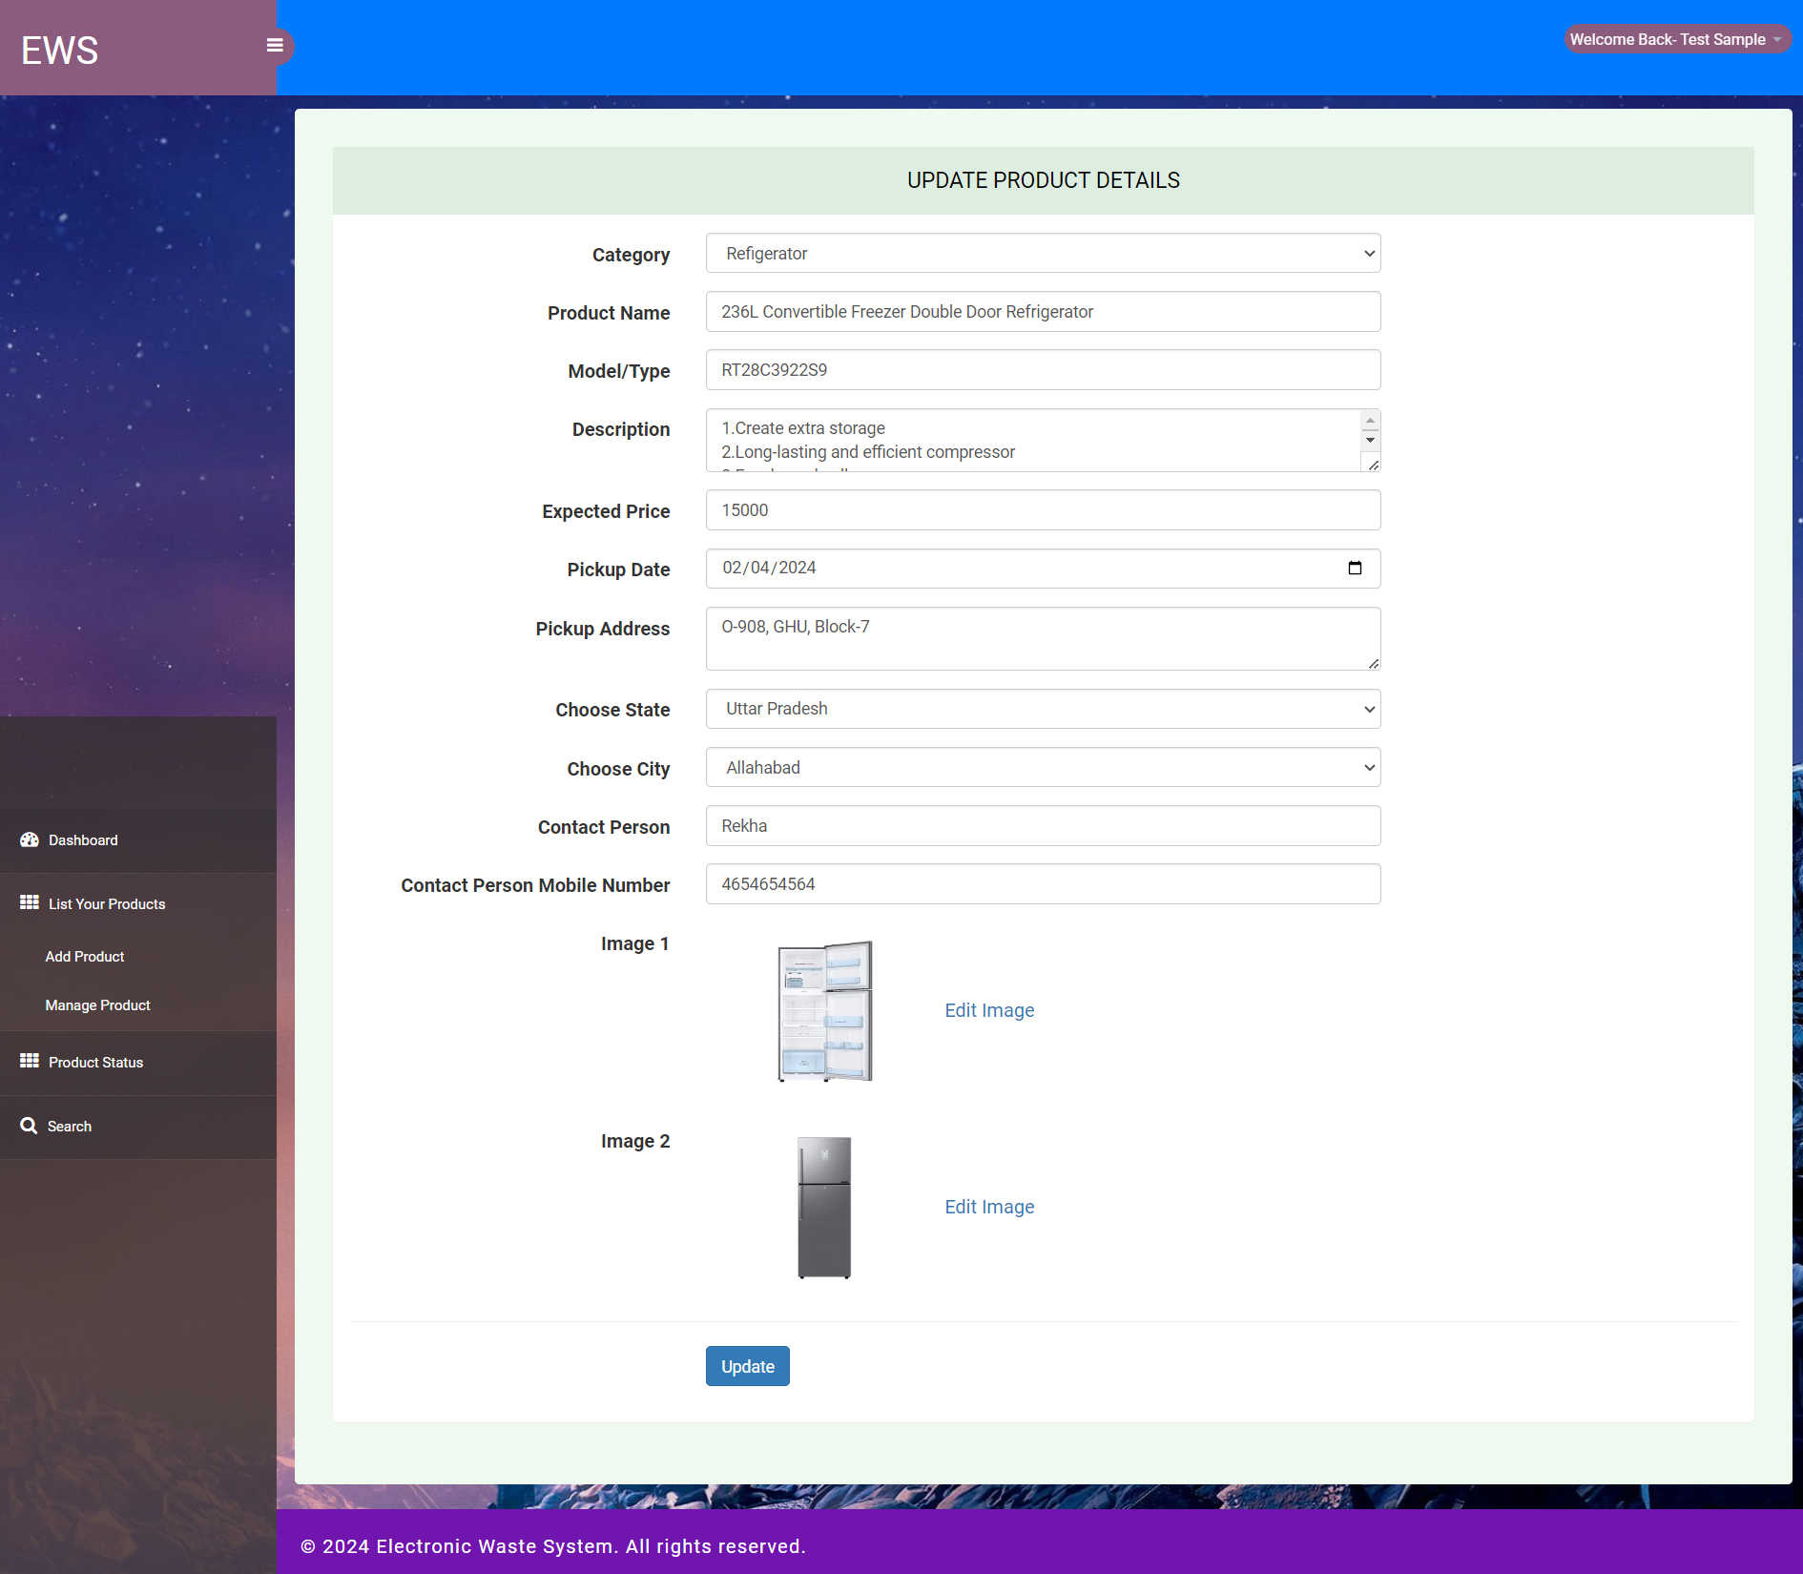

Slide 28
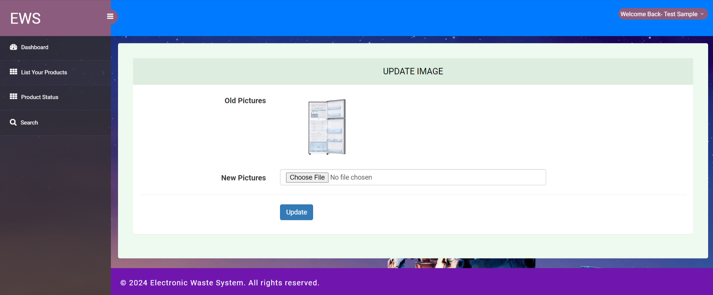
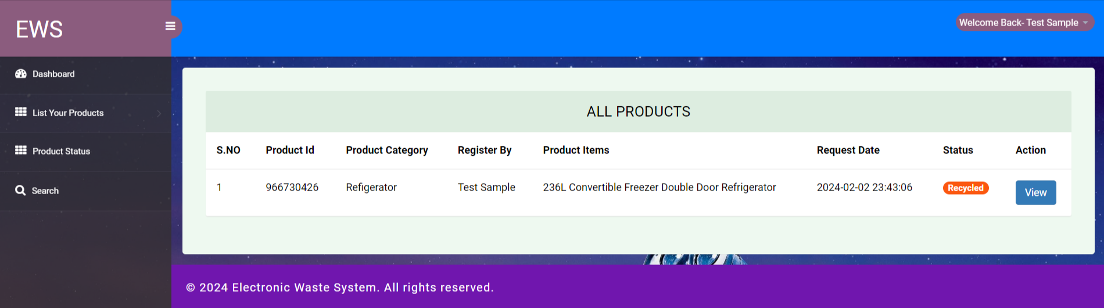

Slide 29
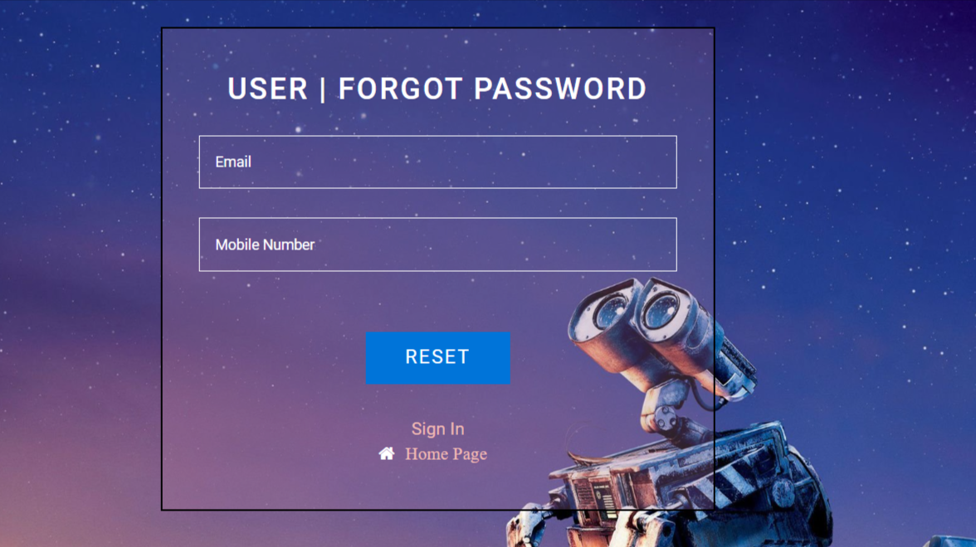
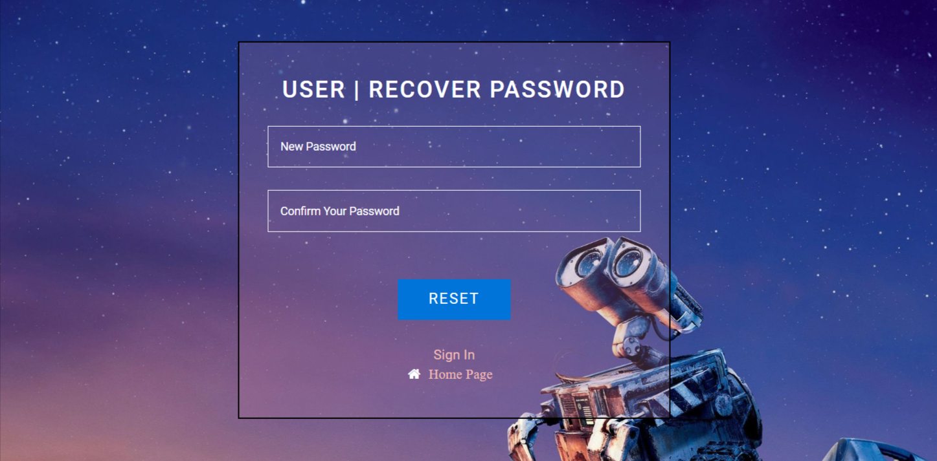

Slide 30
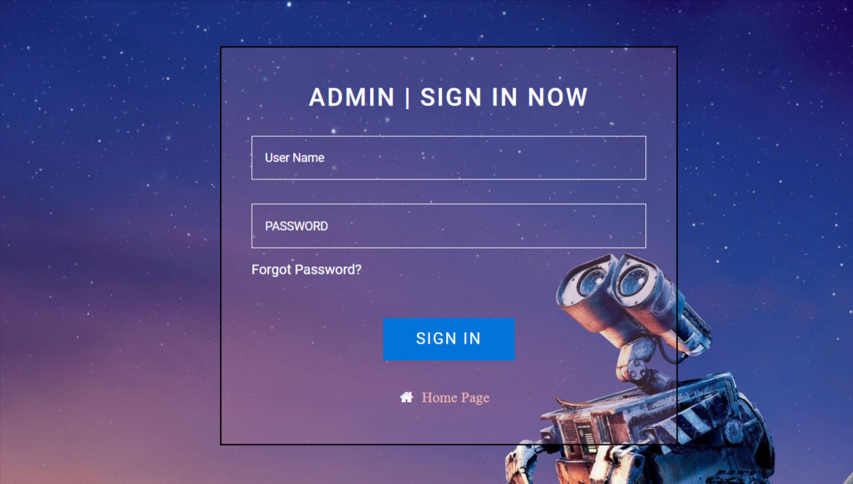
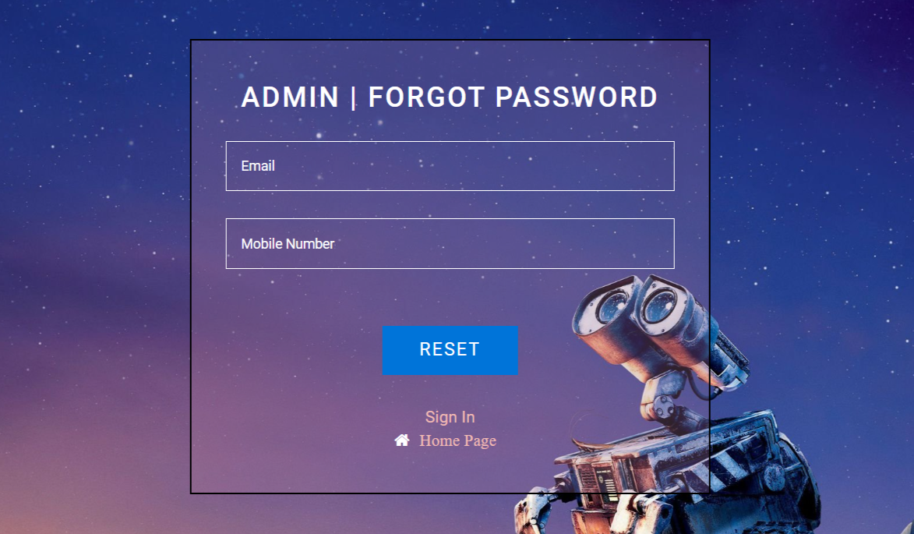

Slide 31
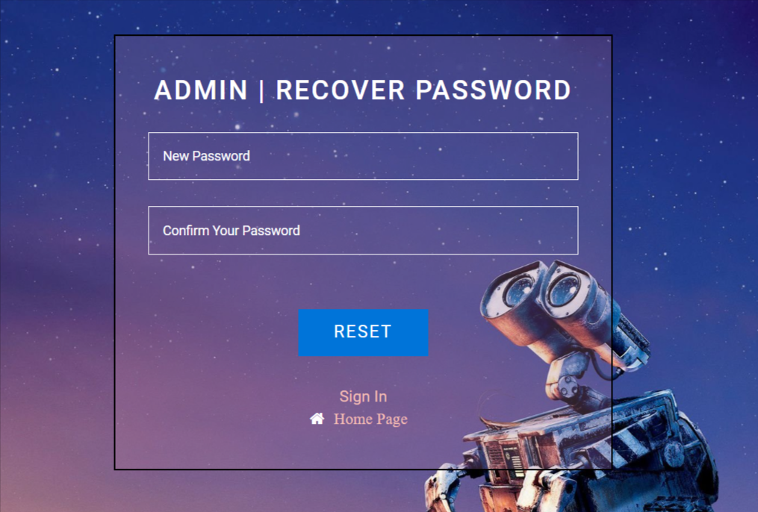
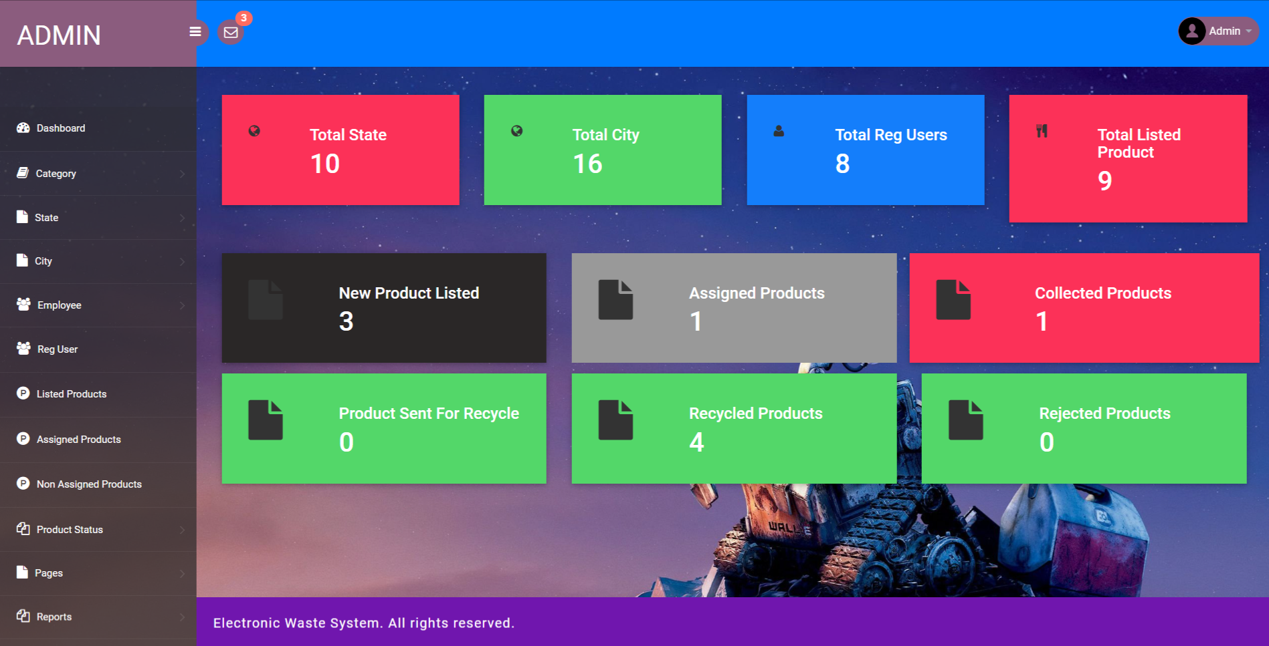

Slide 32
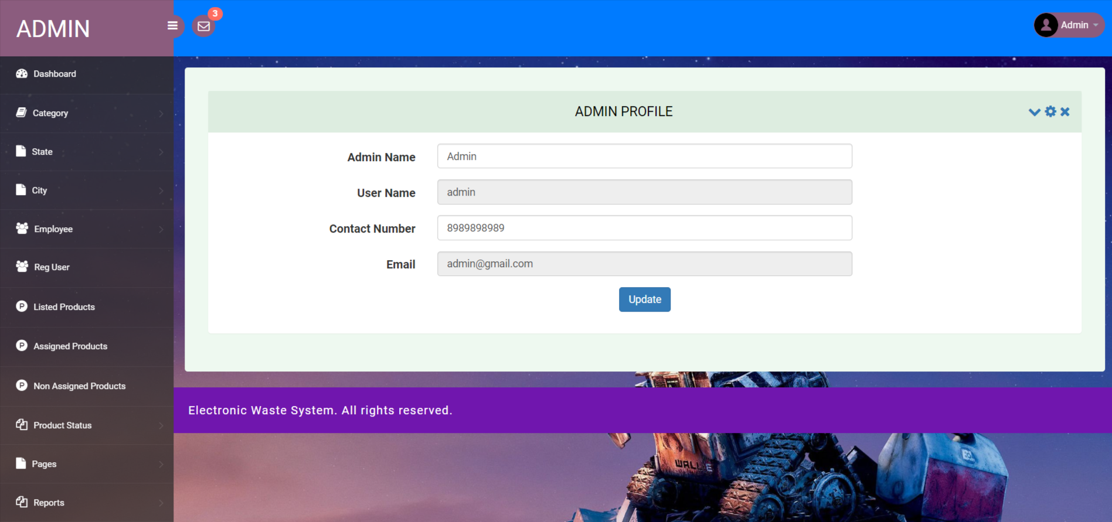
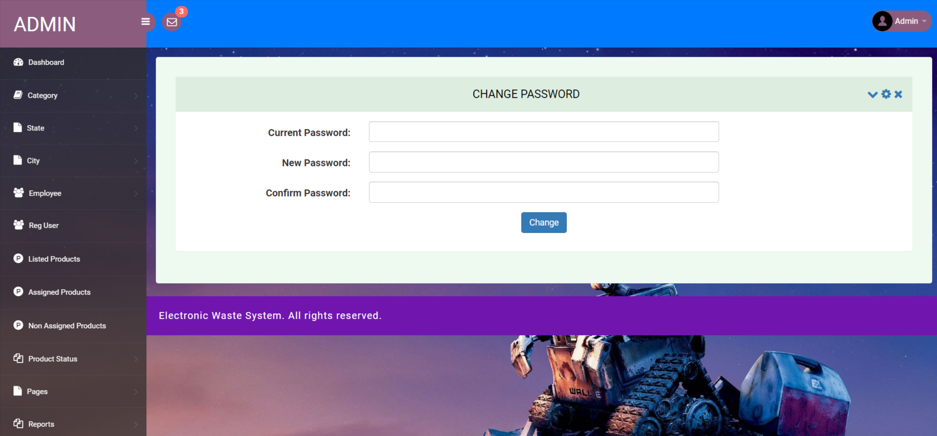

Slide 33
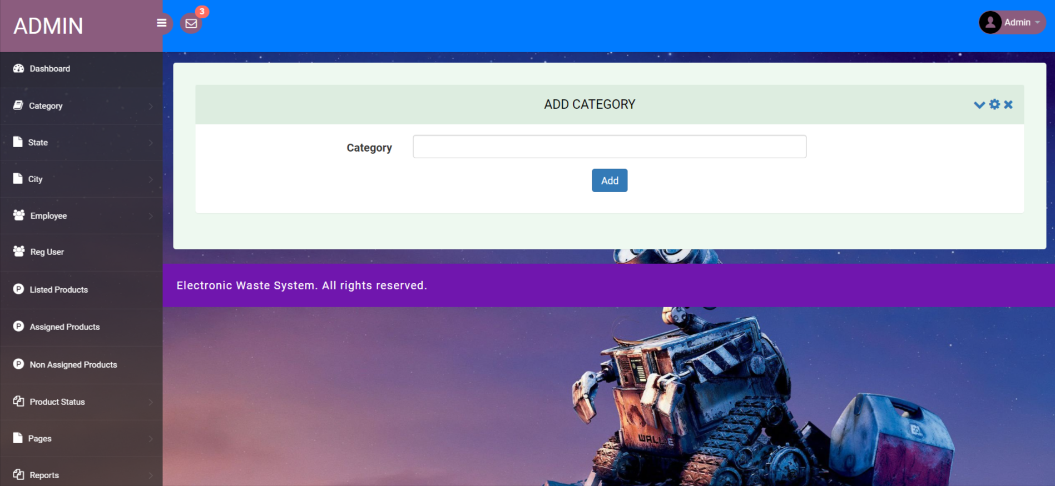
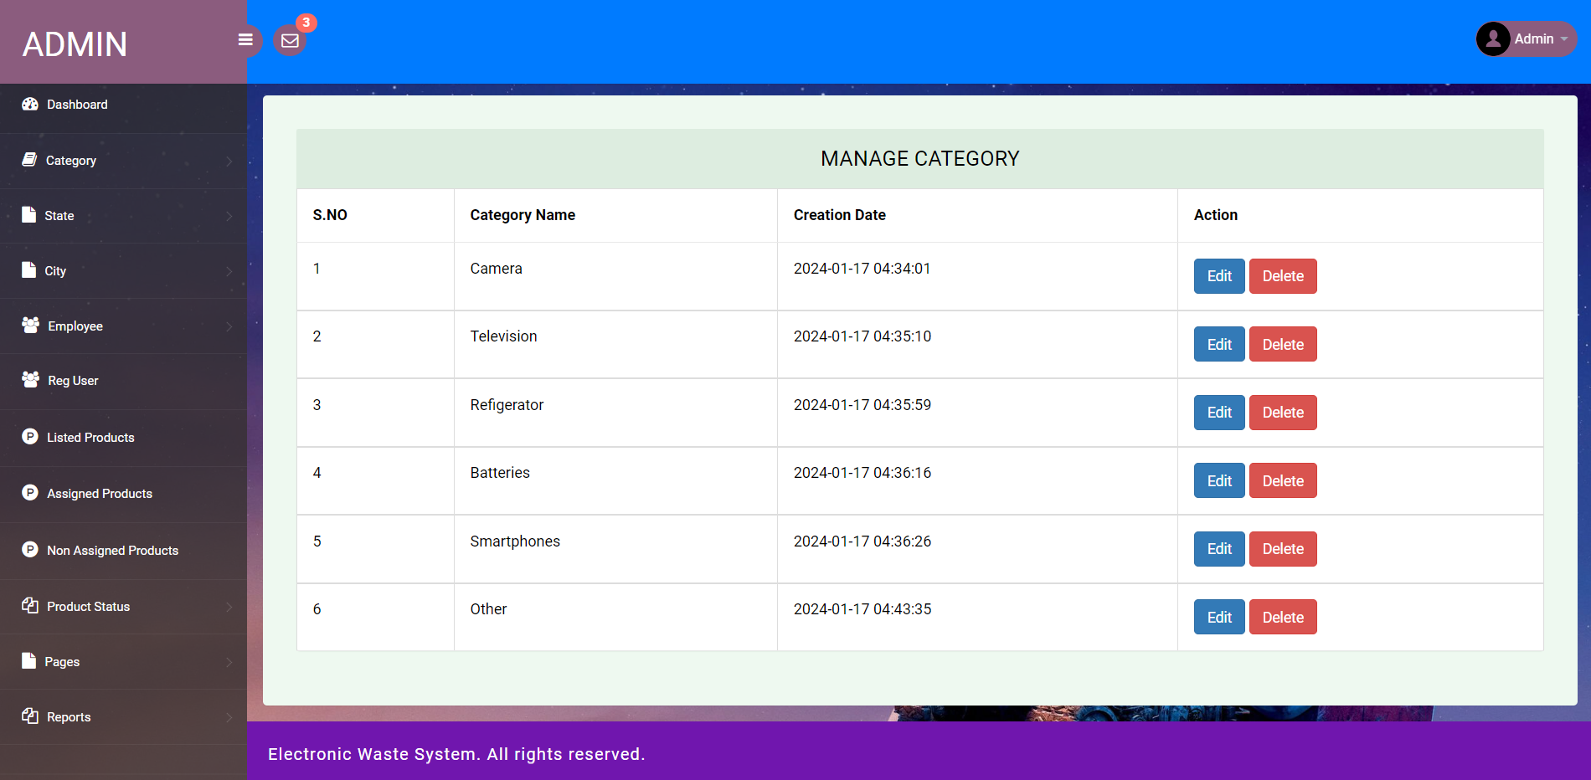

Slide 34
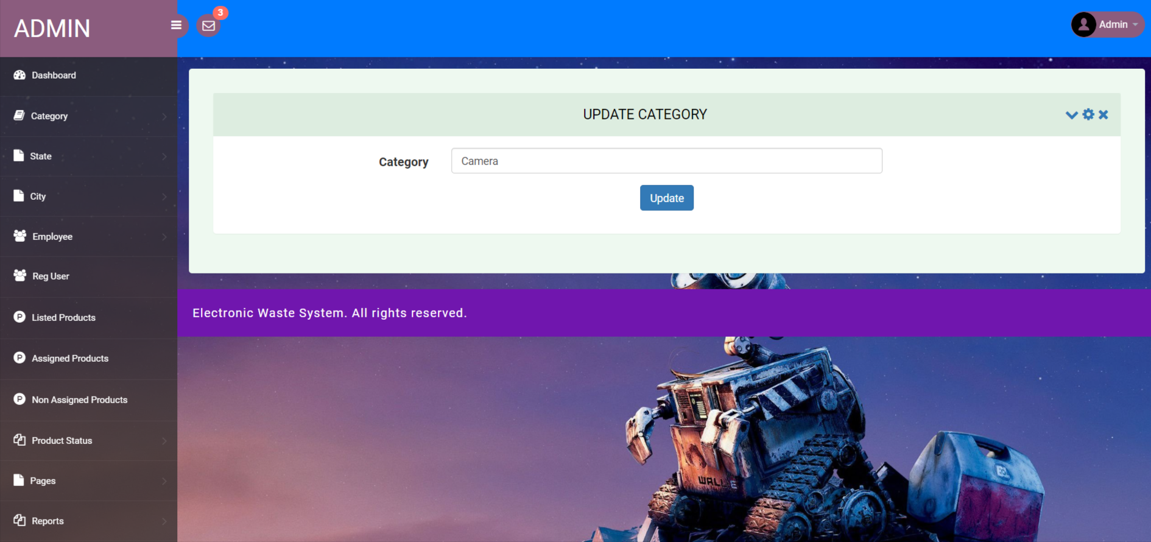
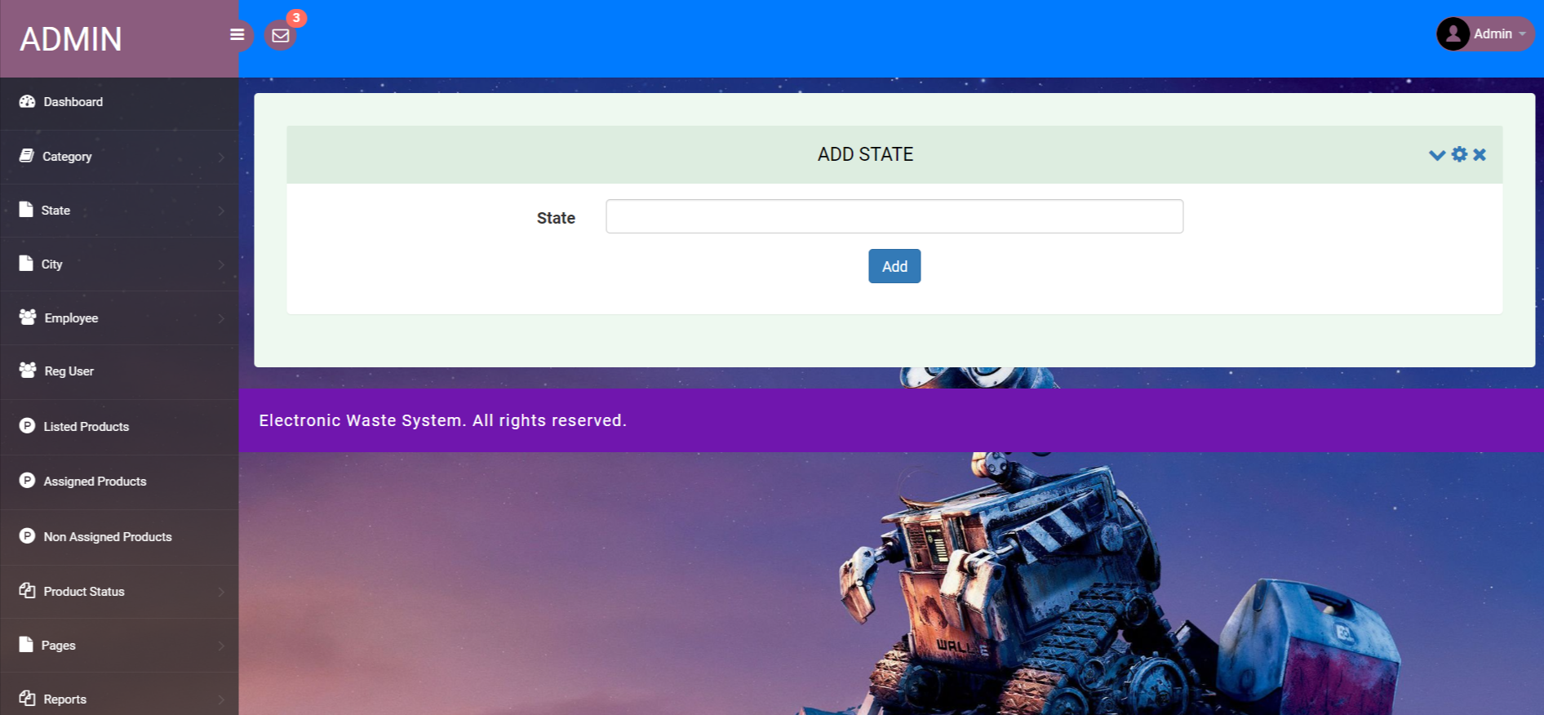

Slide 35
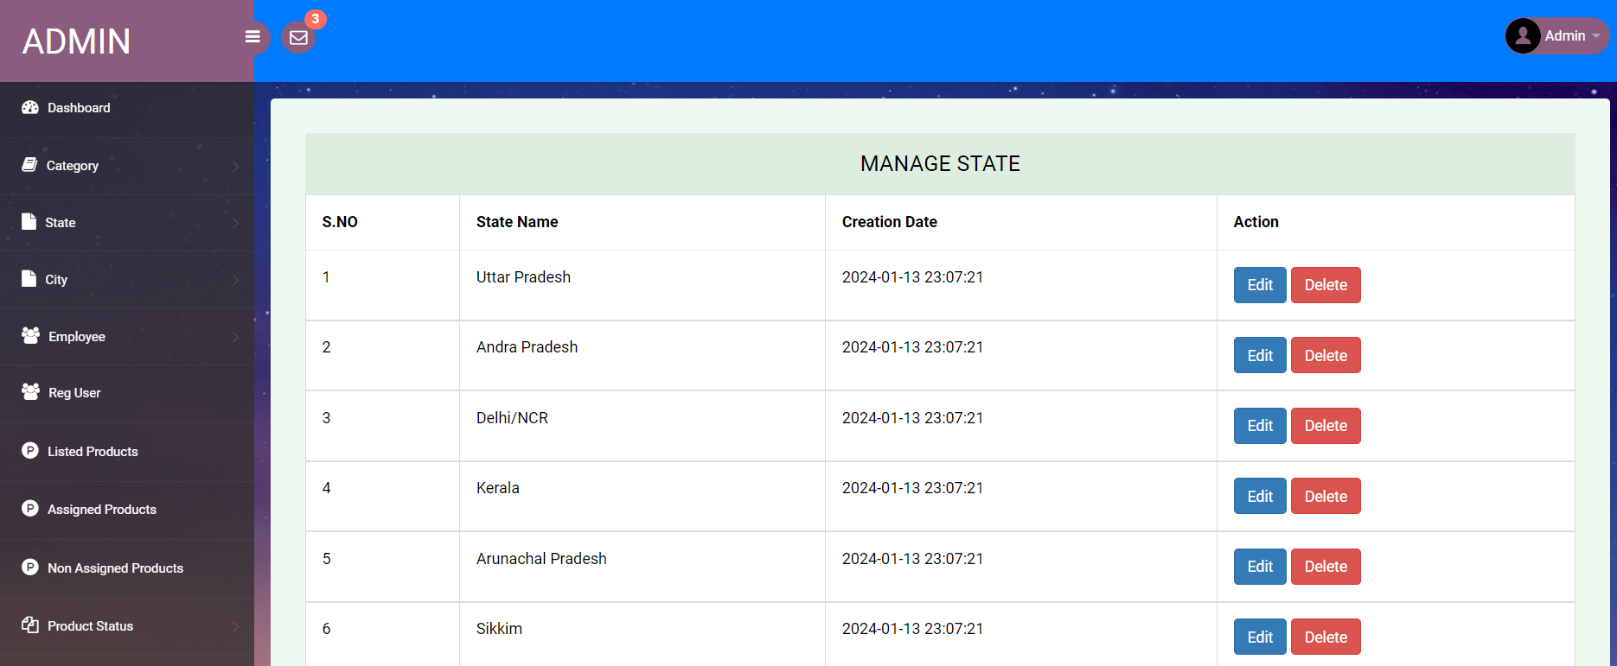
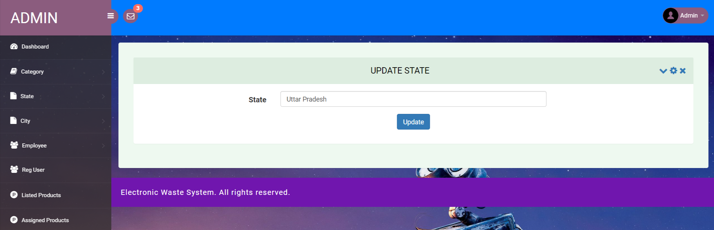

Slide 36
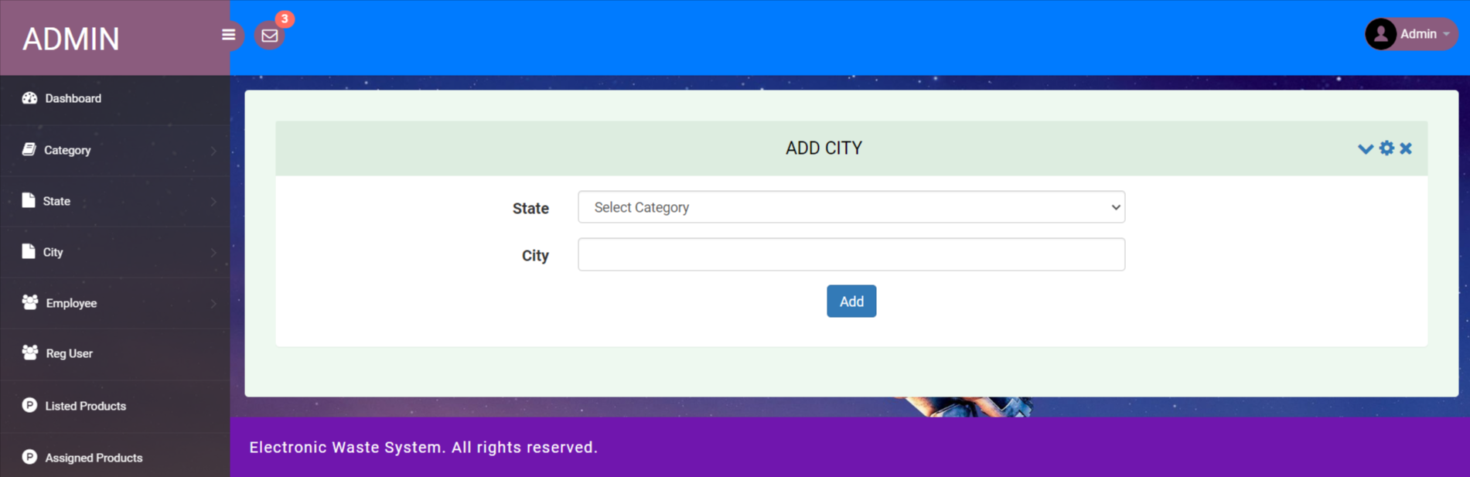
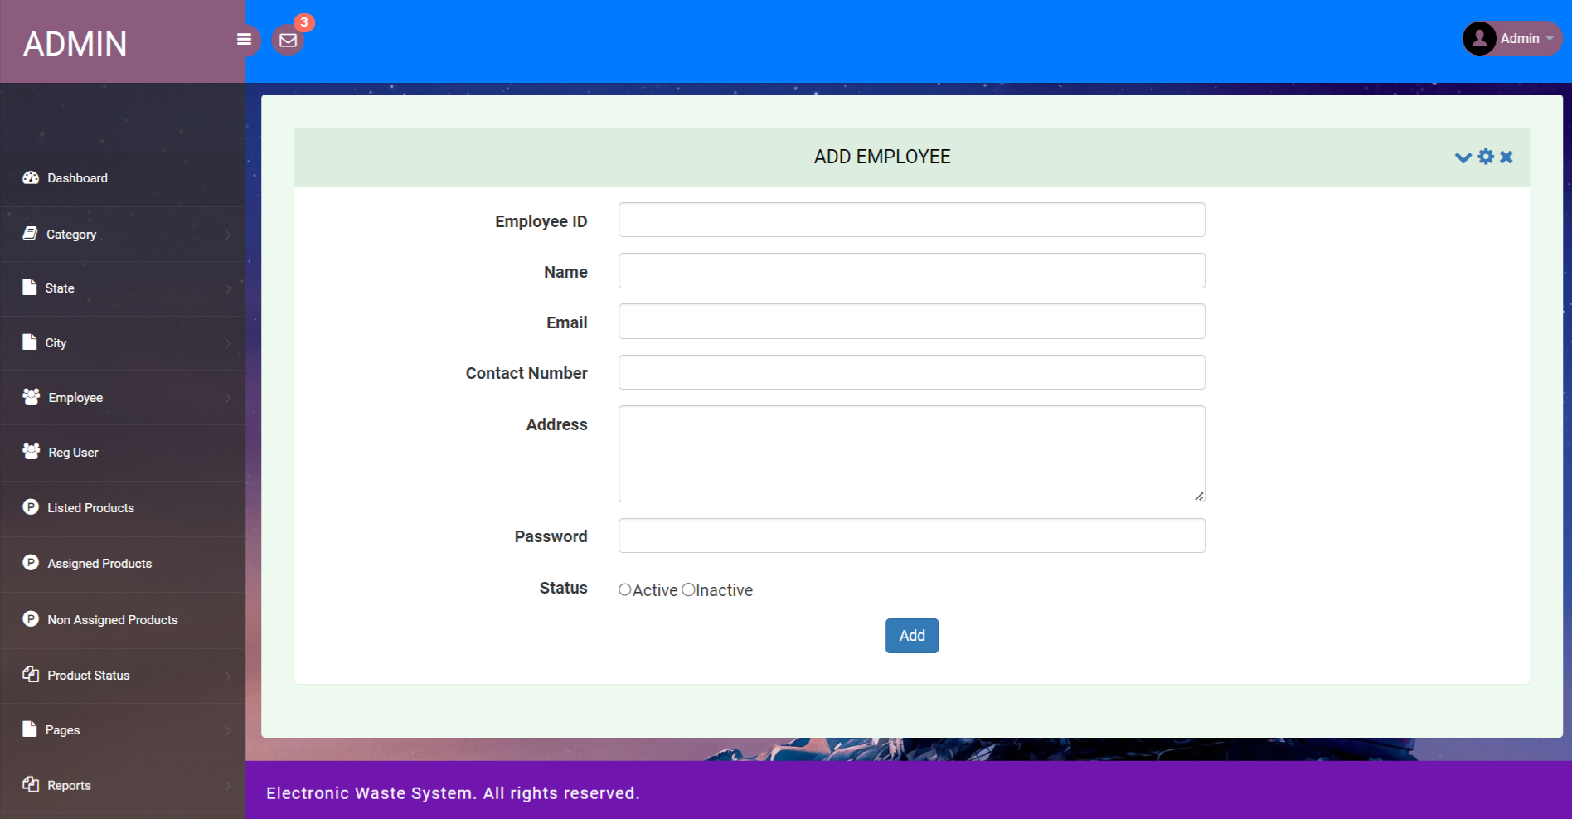

Slide 37
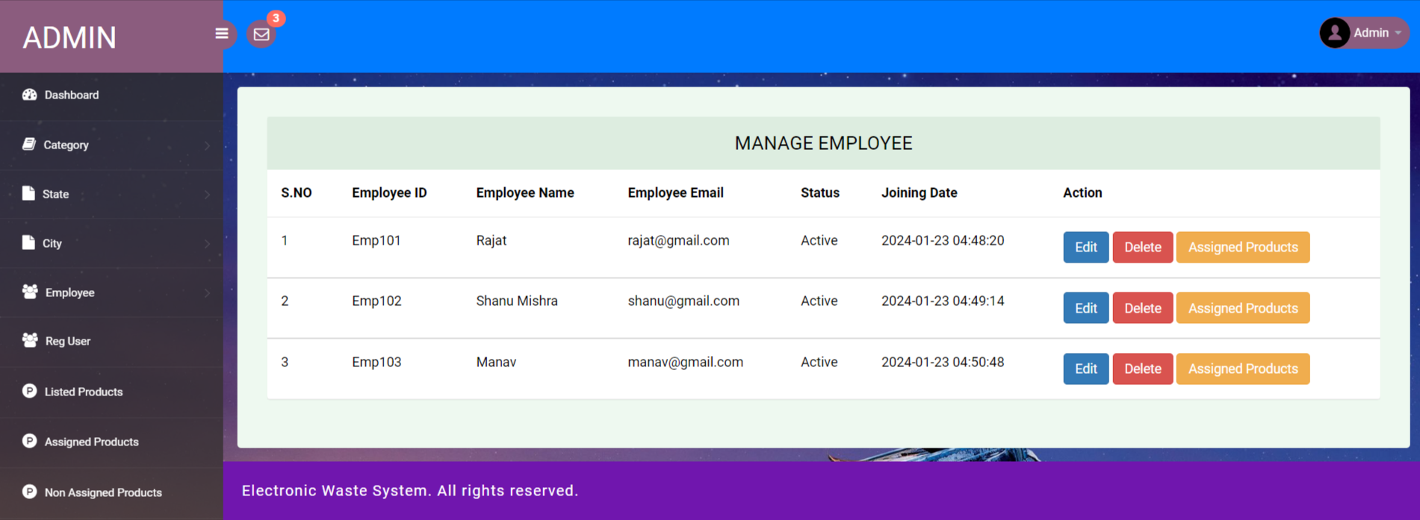
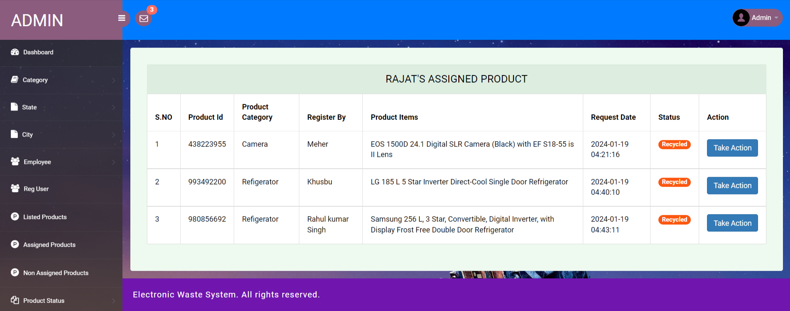

Slide 38
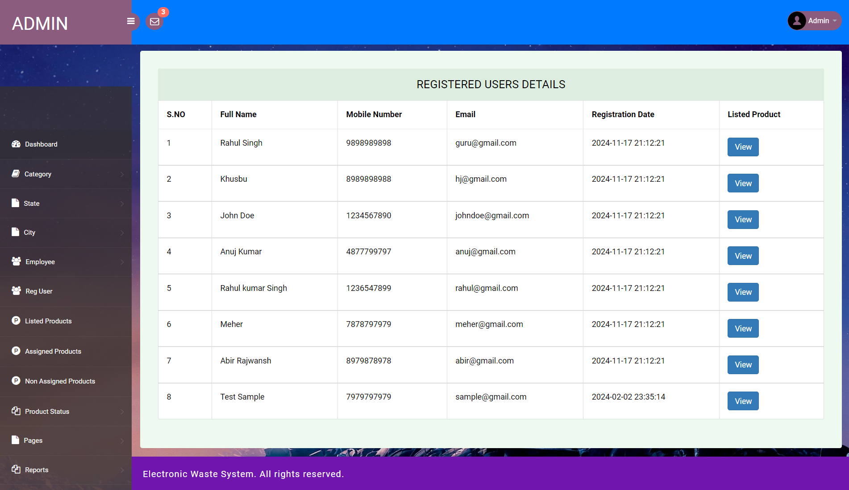
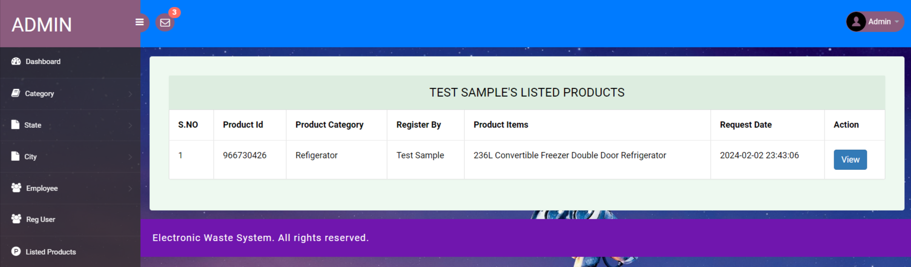

Slide 39
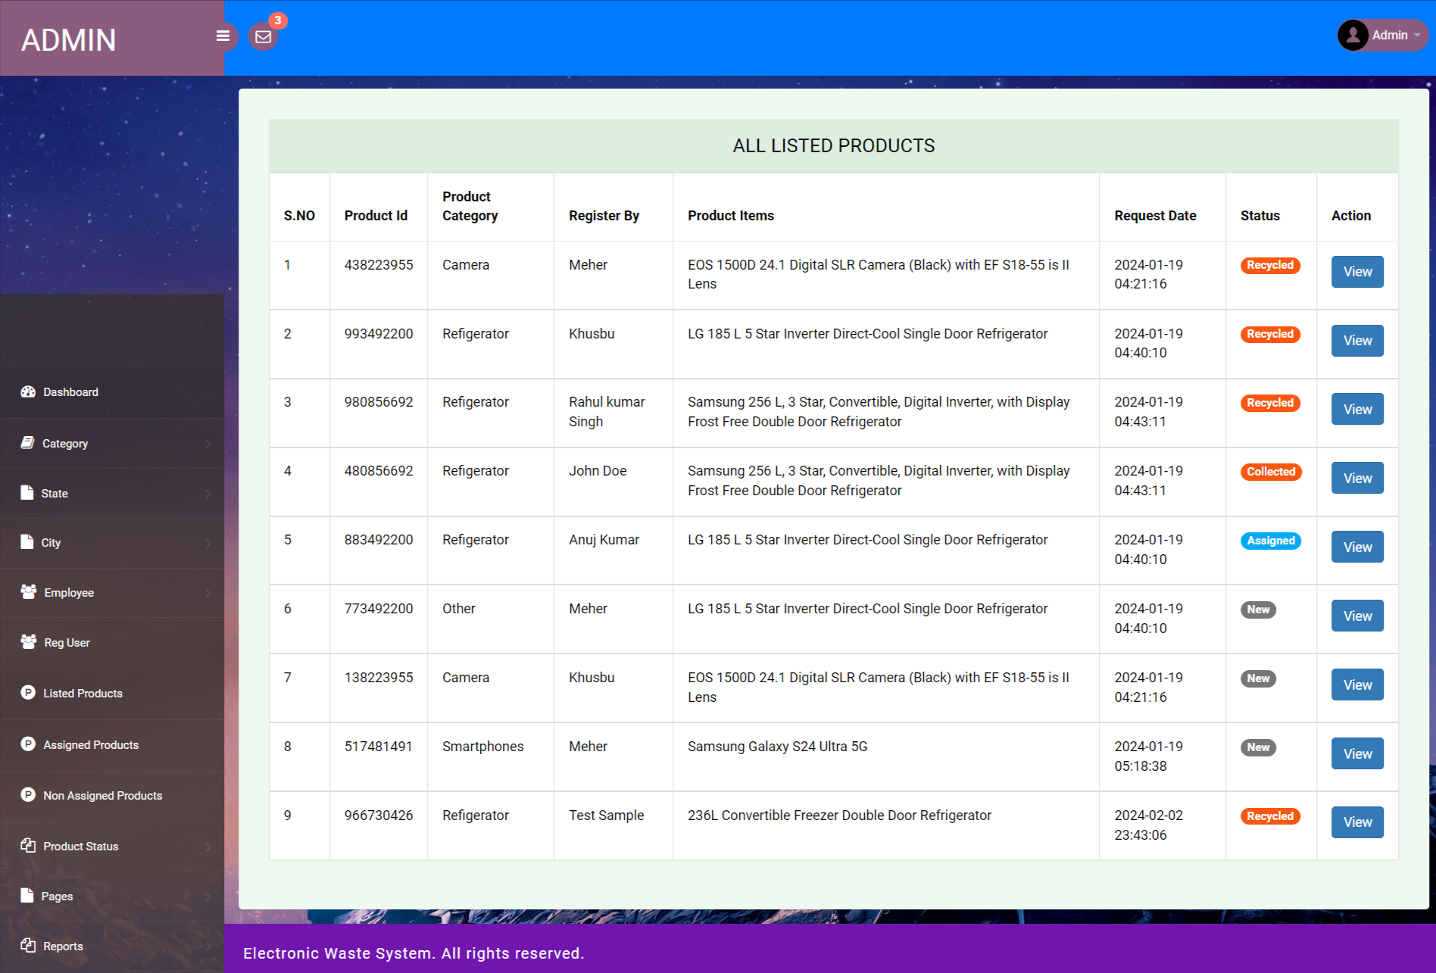

Slide 40
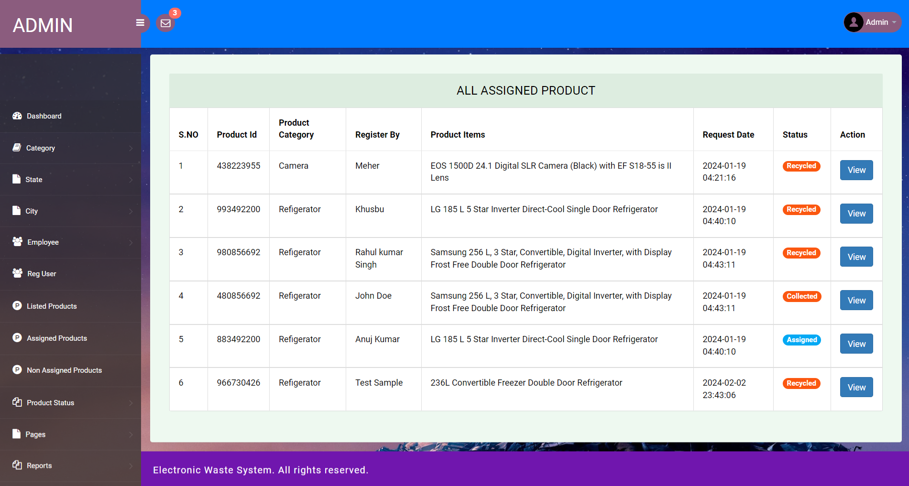
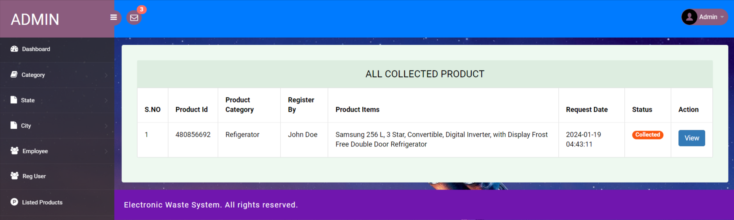

Slide 41
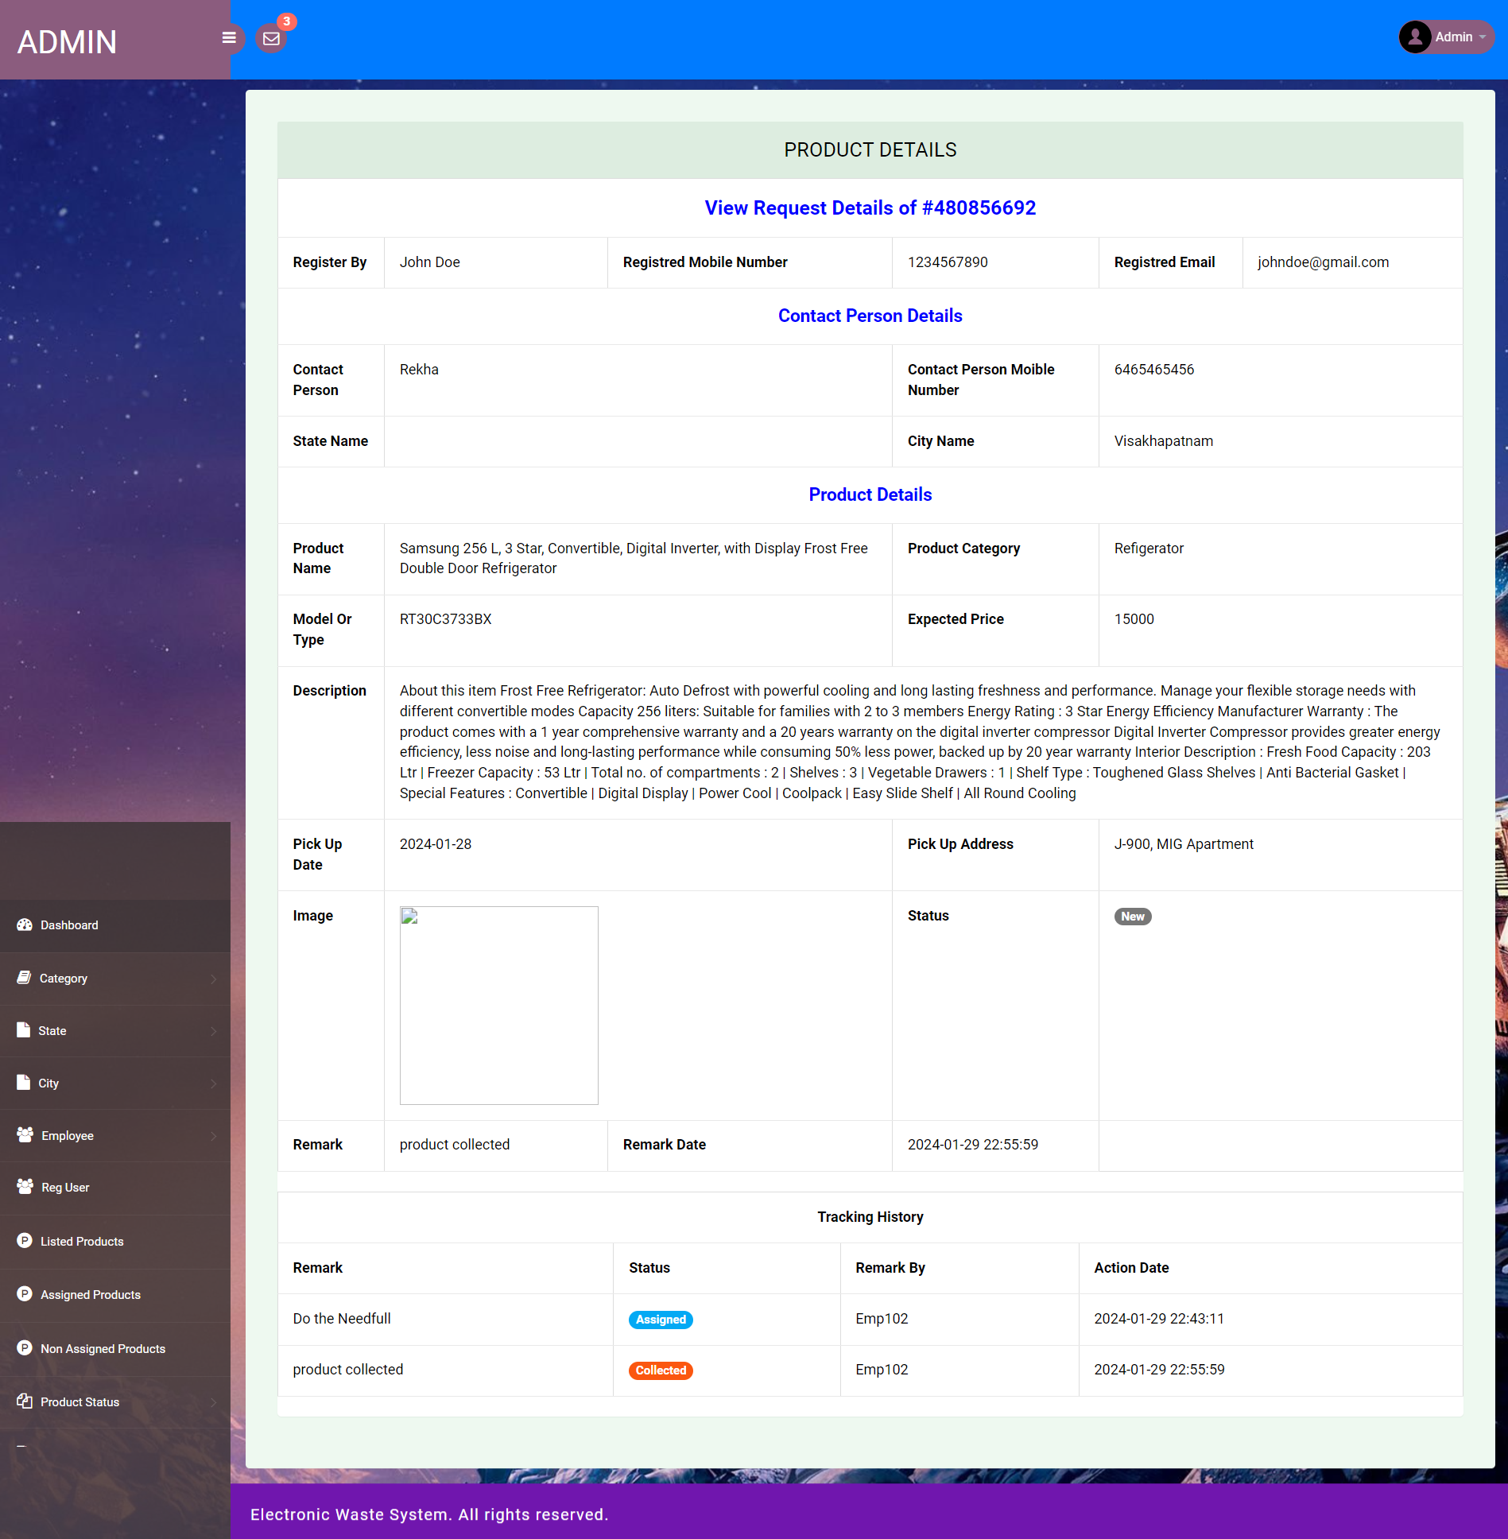

Slide 42
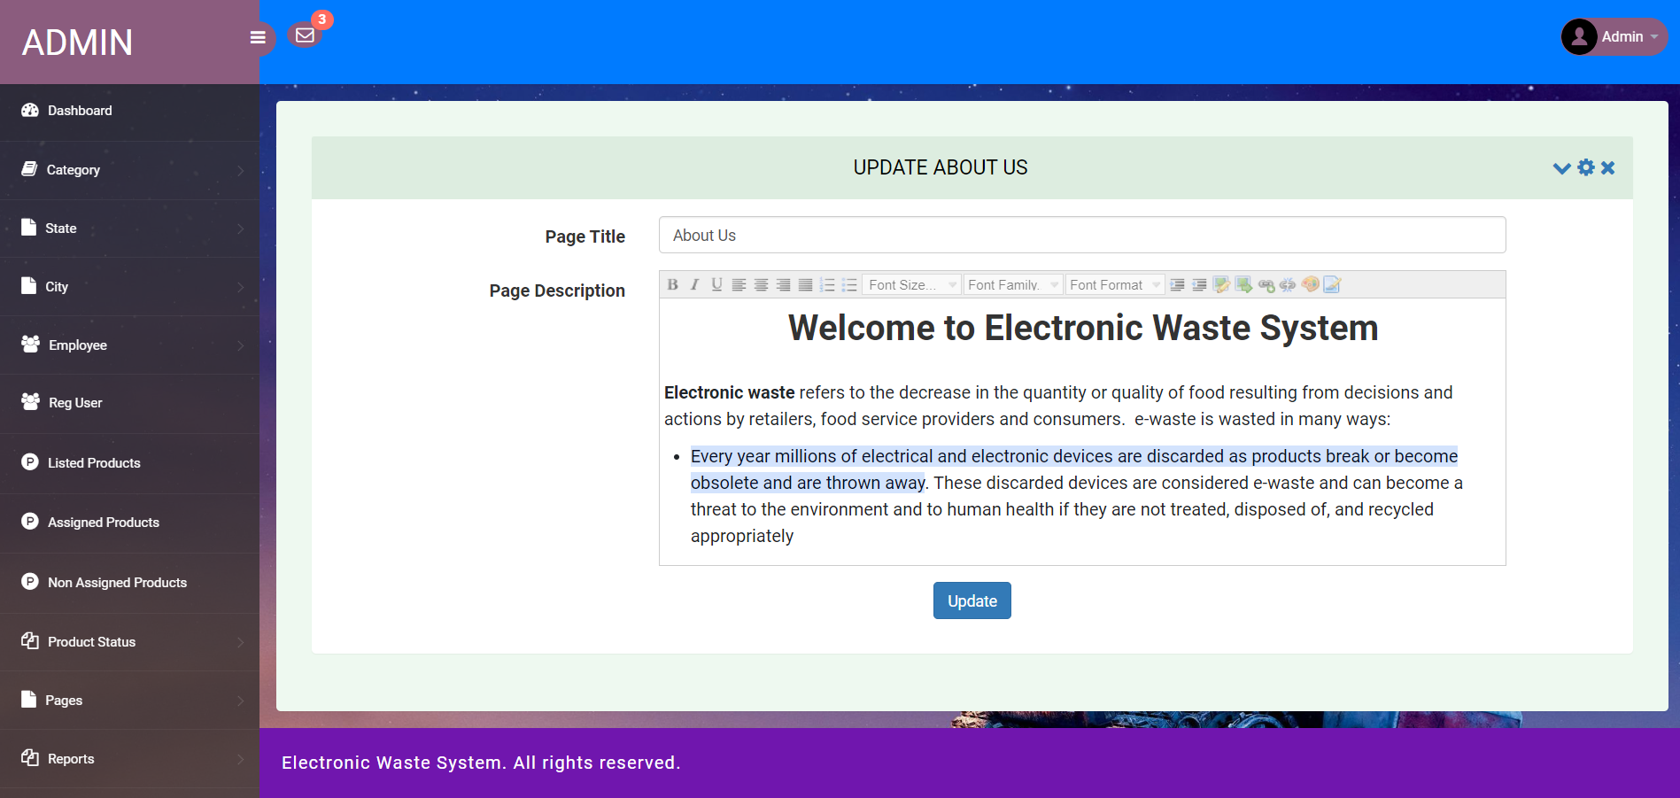
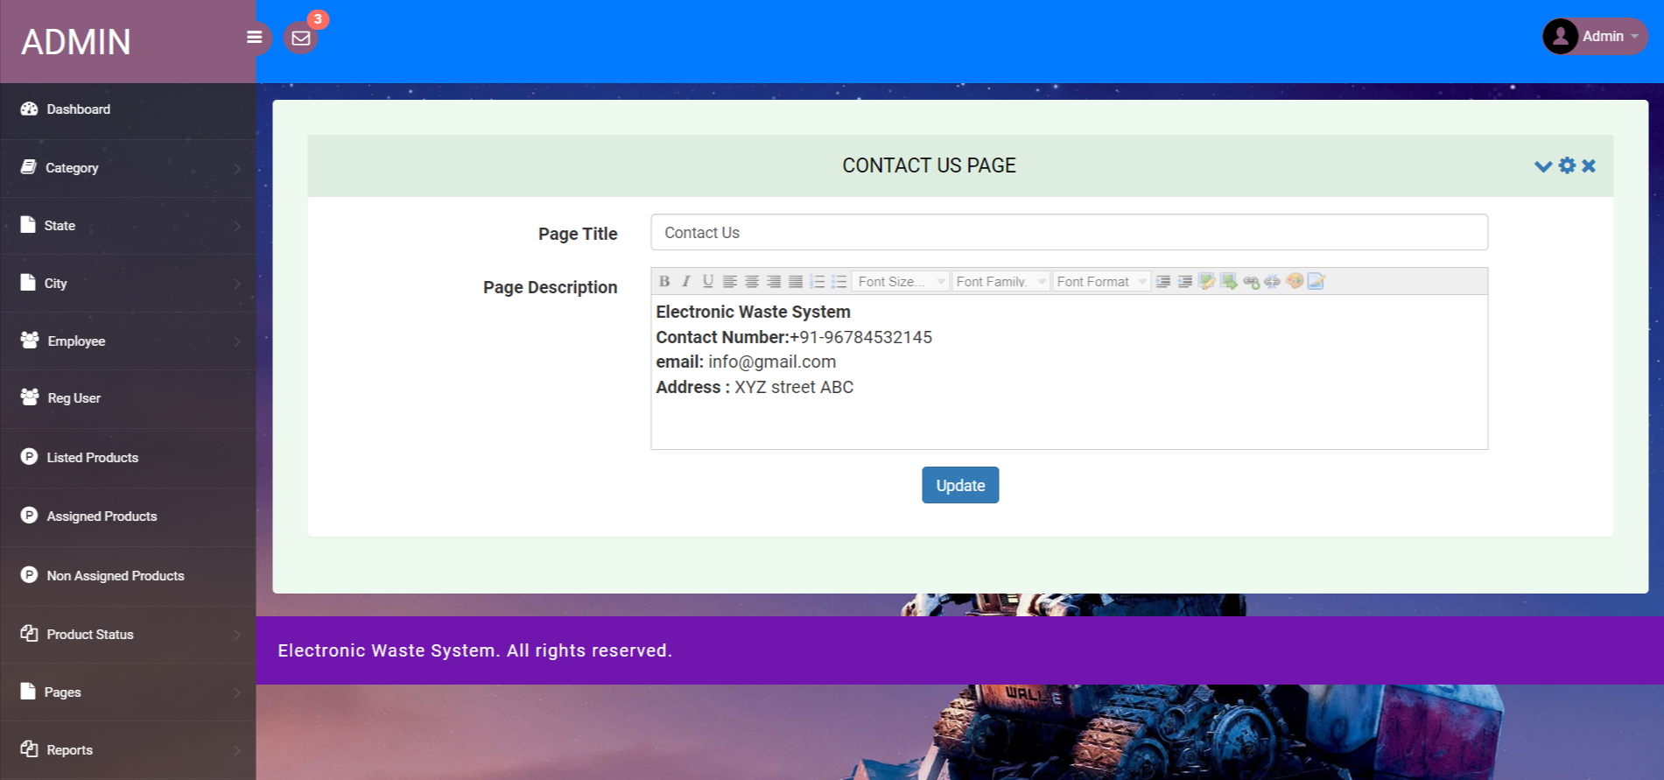

Slide 43
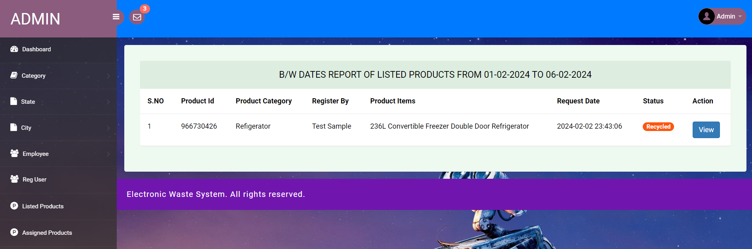
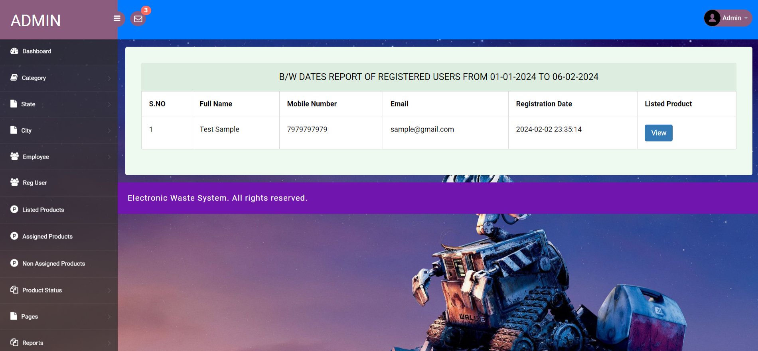

Slide 44
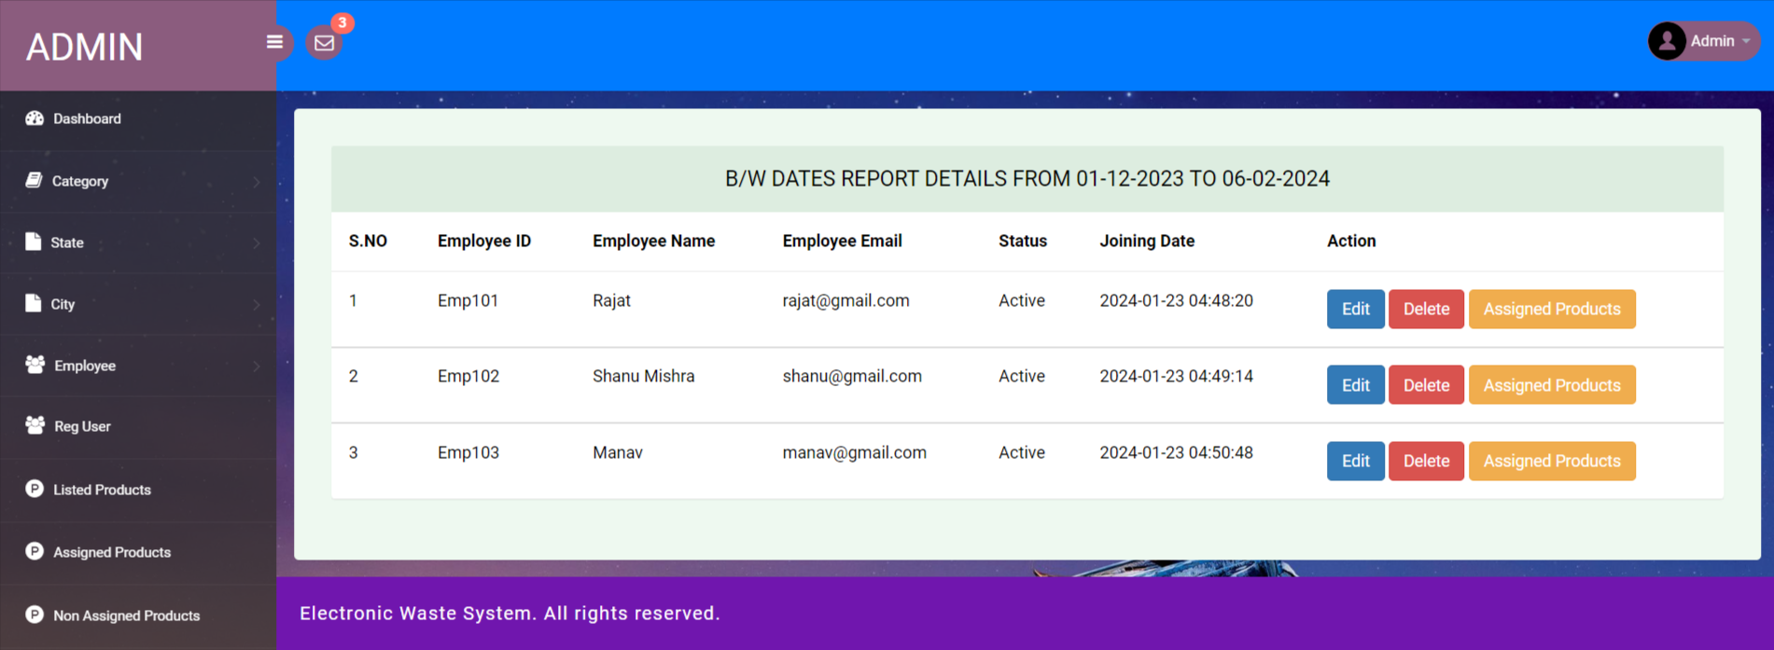


Slide 45



Slide 46



Slide 47



Slide 48




Slide 49


Slide 50


Slide 51
Conclusion
The project titled as Electronic Waste System was deeply studied and analyzed to design the code and implement. It was done under the guidance of the experienced project guide. All the current requirements and possibilities have been taken care during the project time.
In our project, we are targeting to minimize the adverse impacts of e-waste products by using the methodology of reduce, reuse and recycle of e-waste. In our future work, we will try to integrate with other emerging technology such as block chain and also it will cover more areas.

Slide 52
References
For PHP
https://www.w3schools.com/php/default.asp
https://www.sitepoint.com/php/
https://www.php.net/
For MySQL
https://www.mysql.com/
http://www.mysqltutorial.org
For XAMPP
https://www.apachefriends.org/download.html

Slide 53
Thank You

